Slide 1
What is Hive
Notes:
Hi. Let’s try and understand what is Hive?

Slide 2





Notes:
Back when Facebook started in 2004, it started with a database in the backend. But soon…
<<click>>
The data started to grow at Facebook and it started becoming difficult to handle such data.

Slide 3
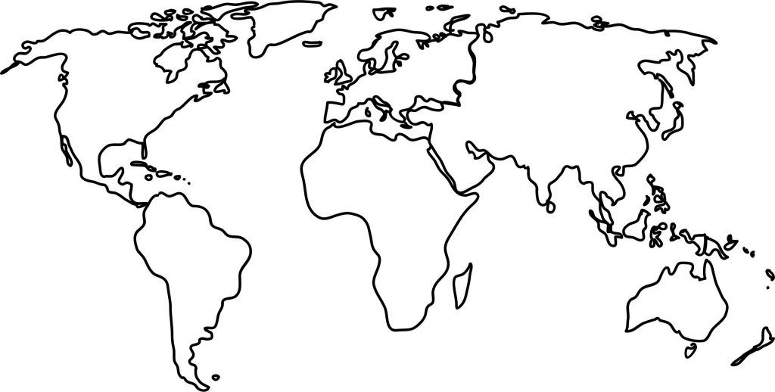

Notes:
So…
<<click>>
Facebook decided to move to Hadoop, around 2006, to manage all the Big Data, which was about a few Tera Bytes per day.

Slide 4
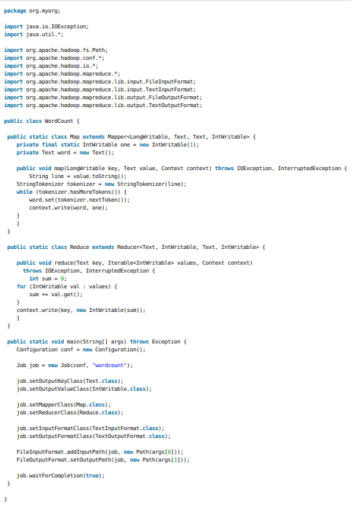

63 lines!!!
Map-Reduce
Notes:
But the people at Facebook were finding it difficult to write Mapreduce code which required writing multiple lines of Java code…
<<click>>
even for something that could have been done with a simple SQL query.

Slide 5

SQL like??
Notes:
So, they decided to build something to bring SQL like simple querying to….

Slide 6
+
SQL like??
On Hadoop??
Notes:
…..Hadoop’s distributed framework.

Slide 7


Hive!!
Notes:
This is where Hive came into the picture.

Slide 8
Hive!!
Data Warehouse built on top of Hadoop.
Notes:
Hive is a data warehouse built on top of Hadoop. A data warehouse, in short, is a central store of information for later analysis. It stores information in a standard format which makes it very easy to query it and extract useful insights.

Slide 9
Hive!!
Data Warehouse built on top of Hadoop.
Analysis of big data in Hadoop.
Notes:
This allows users to easily manage and analyse huge amounts of data in Hadoop

Slide 10
Hive!!
Data Warehouse built on top of Hadoop.
Analysis of big data in Hadoop.
Hive Query Language
Notes:
Now, Hive has an SQL like interface known as Hive Query Language or HQL. This makes it very easy for SQL experts to work with Hadoop.

Slide 11
Hive!!
Data Warehouse built on top of Hadoop.
Analysis of big data in Hadoop.
Hive Query Language
Map-Reduce tasks
Notes:
But Hive actually acts like an abstraction to Mapreduce because any Hive query that we write, is implicitly converted into one or more Mapreduce jobs. So this saves us from the time consuming task of writing Mapreduce code.

Slide 12
Hive!!
Data Warehouse built on top of Hadoop.
Analysis of big data in Hadoop.
Hive Query Language
Map-Reduce tasks
Tabular format
Notes:
And since Hadoop stores data in a file structure format, Hive provides a way to view the data in a tabular format, much like in RDBMS. It does it by storing a structure of tables in a separate Metastore. This allows it to easily map the file structure of Hadoop to tabular format, which you see in SQL!

Slide 13
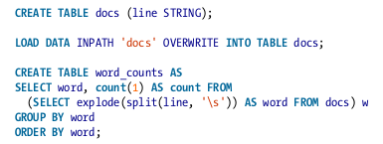

Hive!!
Notes:
This makes Hive an extremely popular tool to work with Hadoop framework because we can easily write a mapreduce code in Hive in just a few lines with the relatable interface of a relational database!

Slide 14
Hive!!
Map-Reduce
Notes:
Now, one thing to keep in mind is that Hive is not a relational database. It cannot track real-time processing because of the higher latency compared to RDBMS.
<<click>>
This is because of the batch nature of map-reduce which makes Hive a poor candidate when it comes to writing simple queries that require low-latency. Therefore, it is best suited for processing on huge datasets.

Slide 15



Who uses Hive?
Notes:
Now, a lot of companies use Hive for analysing huge amounts of data.
<<click>>
Airbnb uses Hive to analyse the data stored for over 3 million hosts.
<<click>>
Guardian, an insurance company, uses Hive for batch processing to provide insurance and wealth management products to its over 27 million customers.
<<click>>
And Vanguard, one of the largest providers of mutual funds in America, uses Hive for performing querying on the data it stores for its customers.

Slide 16
Thank You!
Notes:
That’s it for now. I hope you understood what is hive. See you in

